Slide 1
Module 4
Digital Safety

Slide 2
Module 4 Overview
Welcome to Module 4 of the Teach Digital OERs. Module 4 is about digital safety. Within this module you will learn about how to protect your personal data and methods of improving your safety whilst using digital technologies.
Topic 2 is comprised of information relating to improving your health and wellbeing whilst using digital technologies, highlighting how digital technology can impact us positively and negatively, with some strategies on how to avoid the negative effects of technology.
Within topic 3 you will learn how to protect your devices, such as your mobile phone and modem for your home.
Finally, topic 4 introduces you to the environmental impact that we contribute to when we use technology, and how we can help to avoid this.
01
Protecting personal data and privacy
02
Protecting health and wellbeing
03
Protecting devices
04
Protecting the environment

Slide 3

Topic 1- Protecting personal data and privacy

Slide 4
Relevant Definitions
Before we begin topic 1, here are some useful definitions to help you understand some of the information in this module.
Data privacy generally means the ability of a person to determine for themselves when, how and to what level their personal information is shared with or communicated to others.
Data Security includes a set of standards and different safeguards and measures taken in order to prevent any third party from unauthorized access to digital data, or any intentional or unintentional changing, deletion or disclosure of data.

Slide 5

What is Your Personal Data?
Whenever you are online or use technology, certain aspects of your behaviour is collected by big technology companies.
This is known as your personal data, and will include information you have willingly given to a website or app (such as your name, birthday etc.), but will also include information you might not be aware of it gathering, such as your webpage history, interests and what products/ services you might view regularly.

Slide 6

A Note on Cookies
We mentioned cookies in an earlier module, which are tiny pieces of data that help to speed up a website’s loading times.
However, cookies also collect data about your, and other websites will read them to help give you targeted ads and information.
You may have noticed when you go onto websites that you may not have visited before, you will often need to “accept cookies” to use or view the webpage.

Slide 7

Targeted Ads
Have you ever noticed that you might have Googled something, and then you keep getting adverts for that item on Facebook? This is one of the ways that companies can use your data to give you more targeted results.
Your personal data is very sensitive, and it is anonymous for the most part. Let’s take a closer look at how you can protect your data, and how companies will protect your data too.

Slide 8
Why is Data Privacy Important?
Data Privacy or Information privacy encompasses of 3 main elements:
Right of an individual to be left alone and have control over their personal data.
Procedures for proper handling, processing, collecting, and sharing of personal data.
Compliance with data protection laws.
PROTECTED USEABLE DATA
DATA SECURITY
DATA PRIVACY

Slide 9
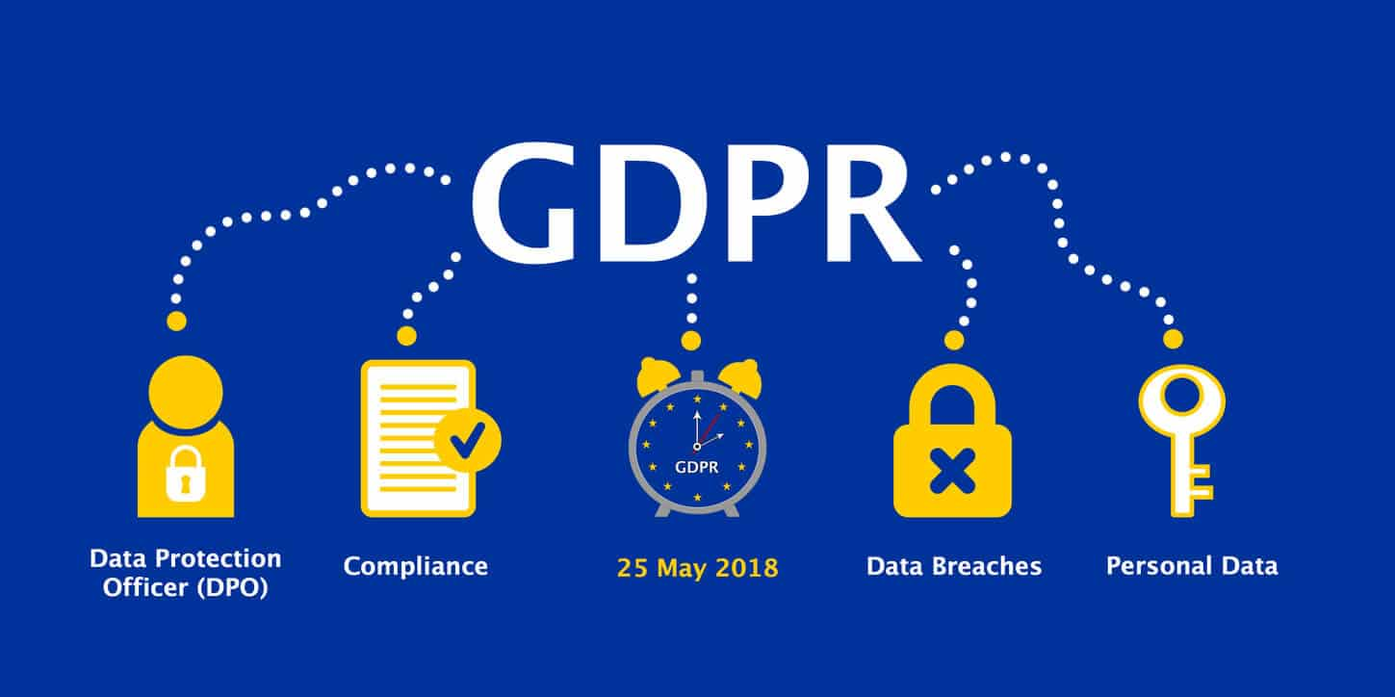
What is GDPR?
The General Data Protection Regulation (GDPR) is the toughest privacy and security law in the world and was brought into effect in May 2018.
GDPR is an important component of EU privacy law and of human rights law. It also addresses the transfer of personal data outside the EU and EEA areas.
Although the GDPR was not the first privacy law, it was the most comprehensive and groundbreaking data protection law that reflected the new digital era in the way data is created and managed in modern everyday business processes.

Slide 10

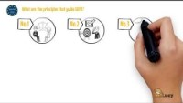


Video: Data privacy and GDPR
Check out this handy video which highlights some of the changes that GDPR has brought in, as well as some information on data privacy.
https://www.youtube.com/watch?v=hk-ZgRIYYXc
Click to watch

Slide 11

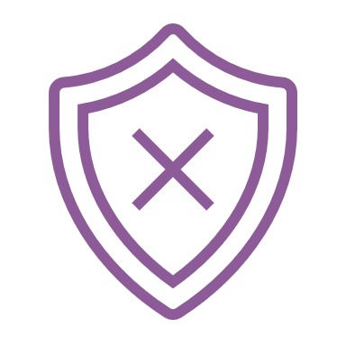
Using and Sharing Personally Identifiable Information
Personally Identifiable Information (PII) is comprised of information that, on its own or combined with a limited amount of other data, can be used to identify a person. Some types of information are considered more sensitive than others.
There are two main types of PII:
Sensitive Personally Identifiable Information
Non-Sensitive Personally Identifiable Information
SOURCE https://usercentrics.com/knowledge-hub/personally-identifiable-information-vs-personal-data/

Slide 12
Sensitive Personally Identifiable Information
Information that is directly tied to a person’s identity, like first and last name or credit card number, is sensitive Personally Identifiable Information, or linked data. This is because this information is directly or almost directly linked to, and can reveal, an individual’s identity.
Some examples include:
Social Security Number
Photo of a face
Credit card number
Account username
Fingerprints
Financial records
First and last name
Home address
Email address
Telephone number
Passport number
Driver’s license number

Slide 13
Examples of Non-Sensitive Personally Identifiable Information
Non-sensitive personally identifiable information is also referred to as linkable data as it requires more data elements to be linked together to establish an individual’s identity than just these pieces of information on their own.
Some examples of Non-Sensitive Personally Identifiable Information includes:
First or last name (if it’s common)
Mother’s maiden name
Partial address, like a country or postal code
Age range, e.g. 35-44
Date of birth
Gender
Employer

Slide 14
Privacy Policy Statements
You may have noticed when you use the internet, that you often need to accept cookies to use the website. Another pop-up notification that you will often see is a privacy policy statement.
Websites and apps are increasingly prompting you to read and acknowledge their privacy policies, a statement that indicates how a company will handle your data.
A good privacy policy will thoroughly explain the types of information collected, how that information is gathered, and whether it will be shared with third parties. A privacy policy should also indicate how or if your information will be tracked. To minimize information tracking, consider opting out of ad trackers and proactively managing your cookies by deleting them, as well as your history and cache.
Curious about what a privacy policy might look like? Check out Google’s privacy policy by clicking on this link: https://policies.google.com/privacy?hl=en-US

Slide 15
What Should a good Privacy Policy Should Include?
Describe the types of information that’s collected, such as payment methods and IP addresses, and outline how they’re used.
Disclose how information is gathered, including the use of browser cookies.
Identify any third parties or organizations that might have access to your information.
Outline the available privacy choices, with instructions on how to opt out of information sharing — and the consequences of doing so.
Describe the site’s security protocols.
Outline compliance with the Children’s Online Privacy Protection Act (COPPA) if the site collects data from children under 13.
Provide contact information for further inquiries.

Slide 16

Video: How to Create a Privacy Policy for Your Website
Check out this handy video which explains how to create a privacy policy for your website:
https://www.youtube.com/watch?v=PMauhUveLZU
Click to watch

Slide 17

Having Difficulty Understanding a Privacy Policy?
Sometimes a privacy policy can seem quite confusing. Whilst one of the rules behind GDPR is that companies need to have easy to read and understandable privacy policies, sometimes it can still be difficult to understand everything that is included.
If you’re having trouble understanding a privacy policy, try search for it on pribot.org
This site was created by researchers that wanted to simplify privacy documents for the average consumer.

Slide 18

Activity: Self Assessment Quiz
This self assessment quiz helps to show you how the world of online can be very different to real life.
To access the resource, click on the link below:
https://classroom.thenational.academy/lessons/how-the-online-world-is-different-to-real-life-c8vk4d

Slide 19

Topic 2: Protecting health and wellbeing

Slide 20
Relevant Definitions
Before we begin topic 2, here are some useful definitions to help you understand some of the information in this module.
Digital wellbeing is a term used to describe the impact of technologies and digital services on people's mental, physical, social and emotional health.
Technostress is a type of stress that is caused by the rapid changes in technology and occurs as a result of the inability to meet the changing demands of these technologies.

Slide 21
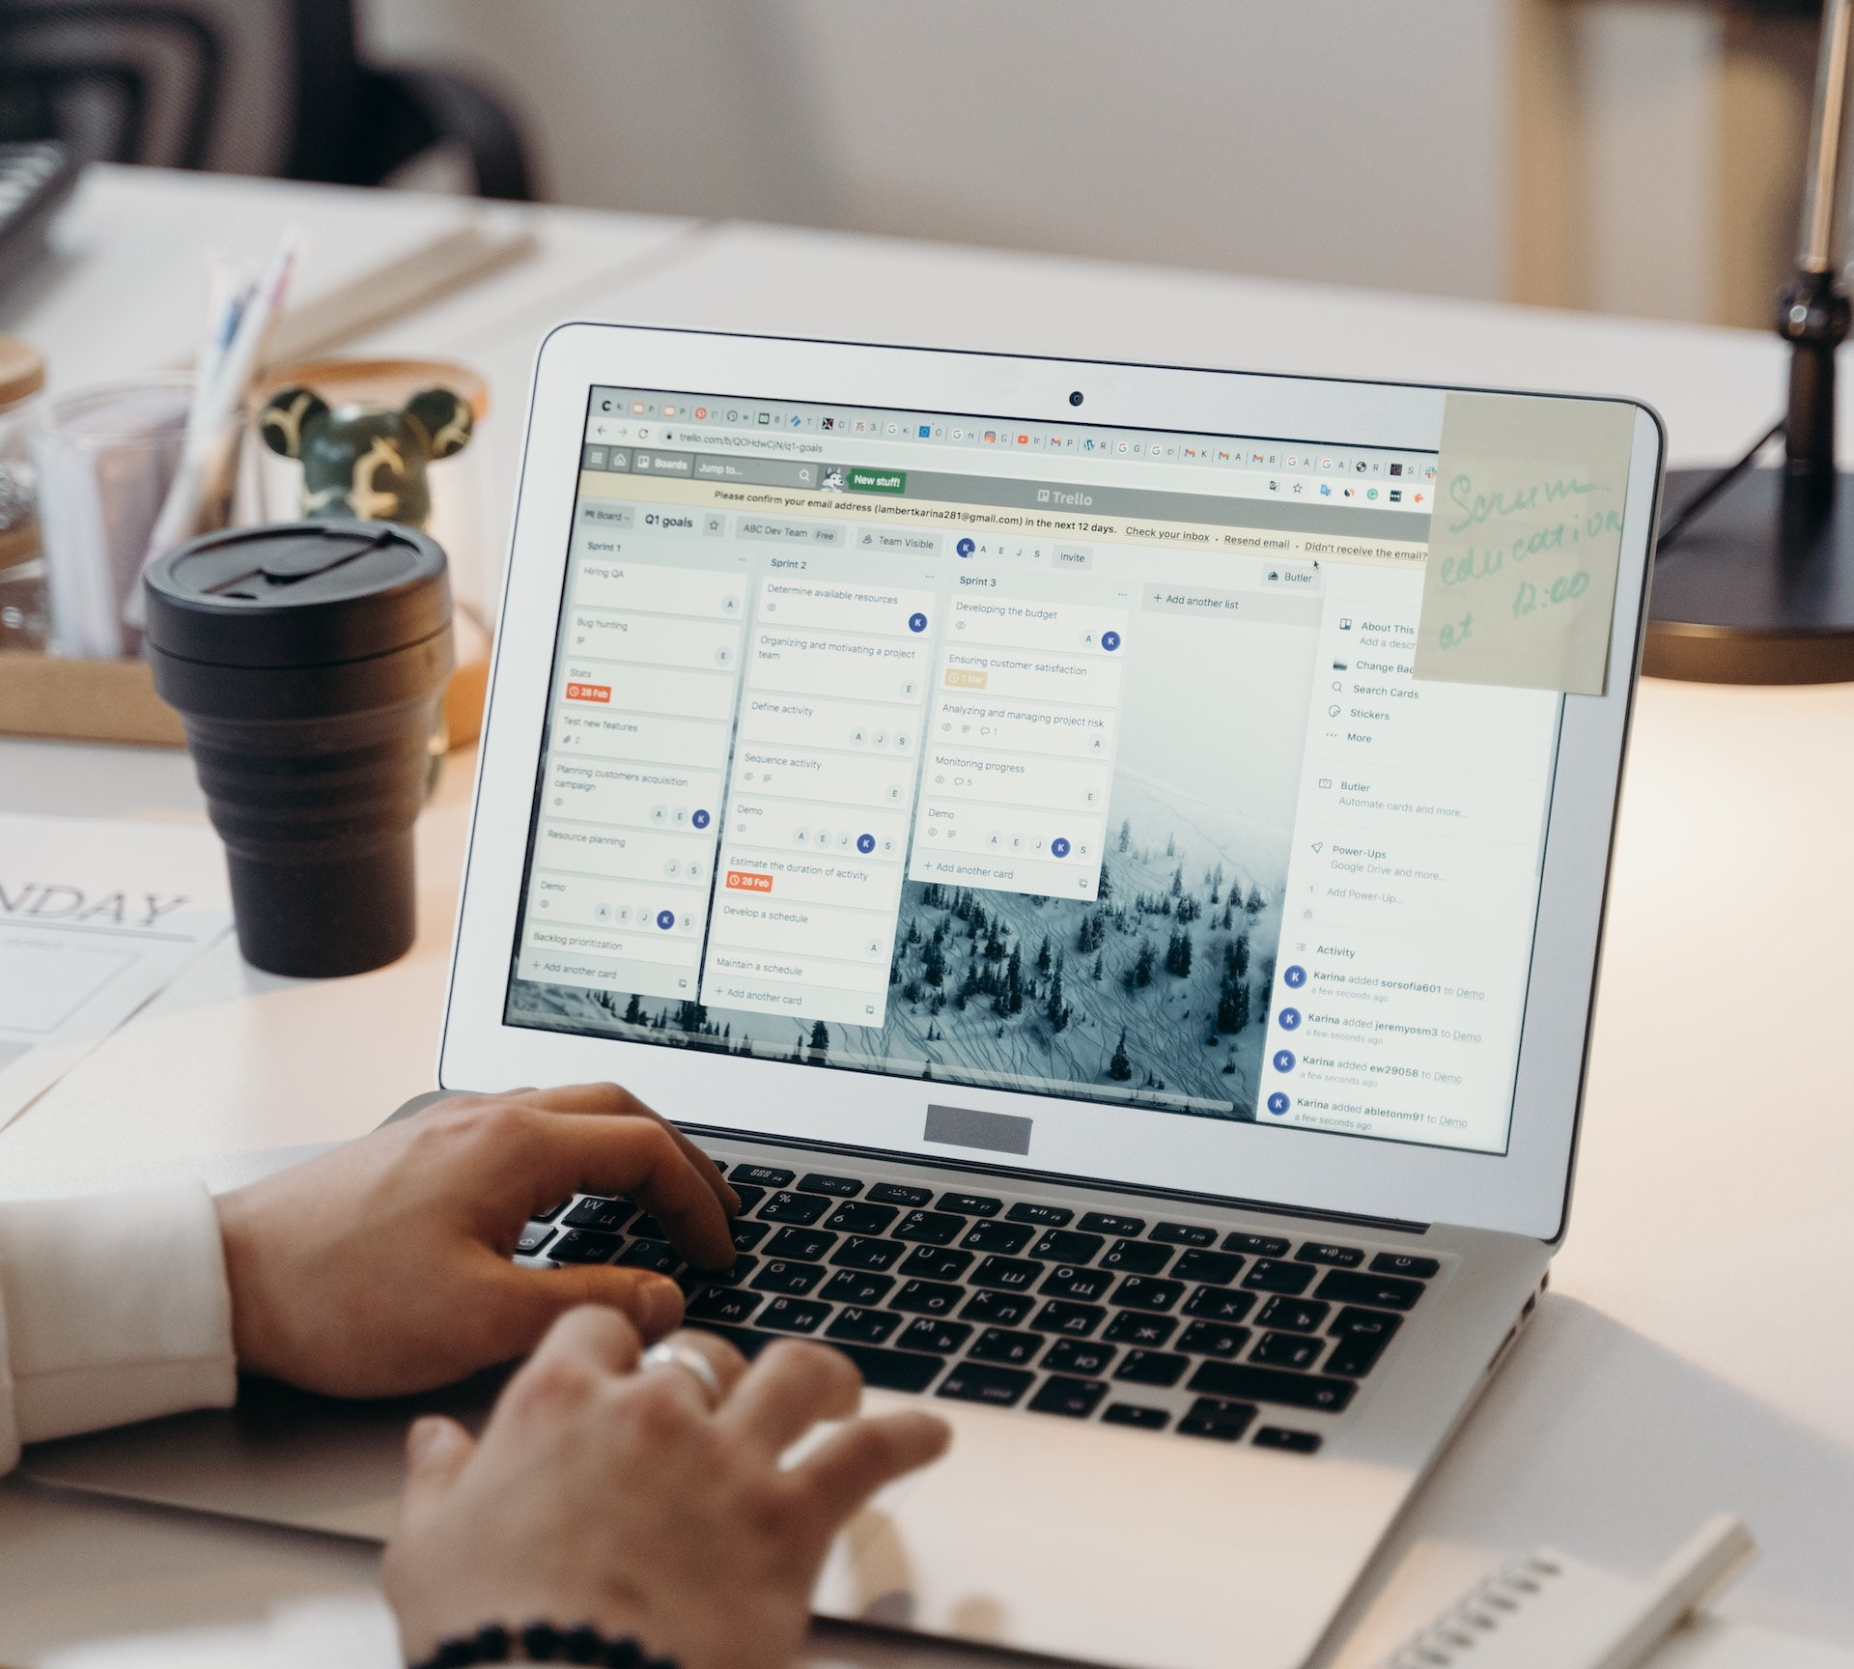
Paying Attention to Technology Use
Throughout the pandemic, as we weren’t able to see each other we have had to rely on technology to ensure that we could still communicate with each other.
Technology used in moderation does not tend to cause issues. However, when used in excess, it can cause different physical and psychological problems.
It is important to be able to recognise the symptoms as technostress and negative digital wellbeing can impact different parts of our lives. In this section we will examine how to avoid some of these potential problems and how to reduce the negative impacts of technology use.

Slide 22
What is Digital Overload?
Digital overload occurs from being constantly on digital platforms and receiving a lot of notifications. As you spend more time using digital technologies, it tends to cause a feeling of being overwhelmed. This is digital overload.
Your brain is a wonderful thing, but it only can do so much. When you are thinking too much, remembering a lot of information, and focusing for long periods of time, it can cause your concentration to be impaired.
You may find that when this happens, you aren’t as resilient, you’re a bit less creative and you can’t concentrate as well as you normally do.
Let’s have a look at some of the potential impacts of digital overload.

Slide 23

Impacts of Digital Overload
The following are some of the impacts of digital overload:
Loss of control of your day-to-day life.
When you feel you cannot put your phone down, and that you just want to be on it because it feels good- this can be seen as a dependence on technology.
Digital overload can impact your mental health.
This can increase stress, anxiety and depression as digital lives expand. Less face-to-face interaction, increased inactivity, poor in-person communication skills and an overall distrust amongst people.

Slide 24

Behaviours of Digital Overload
You might recognize some of the below behaviour that can deteriorate your digital wellbeing:
Internet addiction – shopping online, playing video games, checking Facebook, blogs, videos, social media
Time wasting - spending too much time scrolling, spending less time living in the real world and enjoying interacting with people, exercising etc.
Compulsive checking and compelled to social media- becoming addicted and spending most of your time online
Acting like automatons – acting like we have to respond immediately
Phantom pocket vibrations – perceiving non-existent notifications from smartphones
Google effect – in the always connected world, people are less likely to recall information as easily if they think they can look it up

Slide 25

Click to watch
Watch the Video: Cognitive overload-
Rewire Your Brain In The Digital Age
Take a look at the following Ted Talk video which highlights the speakers experience of cognitive overload regarding digital technologies.
https://www.youtube.com/watch?v=Z0ztO86ImQg

Slide 26

Equipping Ourselves Against The Negatives Of Technology
While is it very easy to focus on the negatives of digital technologies, they are a crucial part of modern-day life. Most of us will use multiple digital technologies throughout our day-to-day tasks.
It is important to equip ourselves with the correct understanding of the dangers of digital technology, but it is also important to have techniques and methods to ensure that we can continue using digital technologies in a safe way.
Let’s take a closer look at some of the negative effects of digital technology use and how to avoid them.

Slide 27

Digital Distraction
Digital Distraction is when you use a digital device (smartphone, laptop, tablet) whilst you engage in another activity.
It occurs when digital devices are used for activities unrelated to work time. This often includes text messaging, emailing, web-surfing, using social media, and playing games.
Due to the digitalization that the pandemic brought on, it is easy to slip into the habit of checking your phone whilst watching the TV.

Slide 28
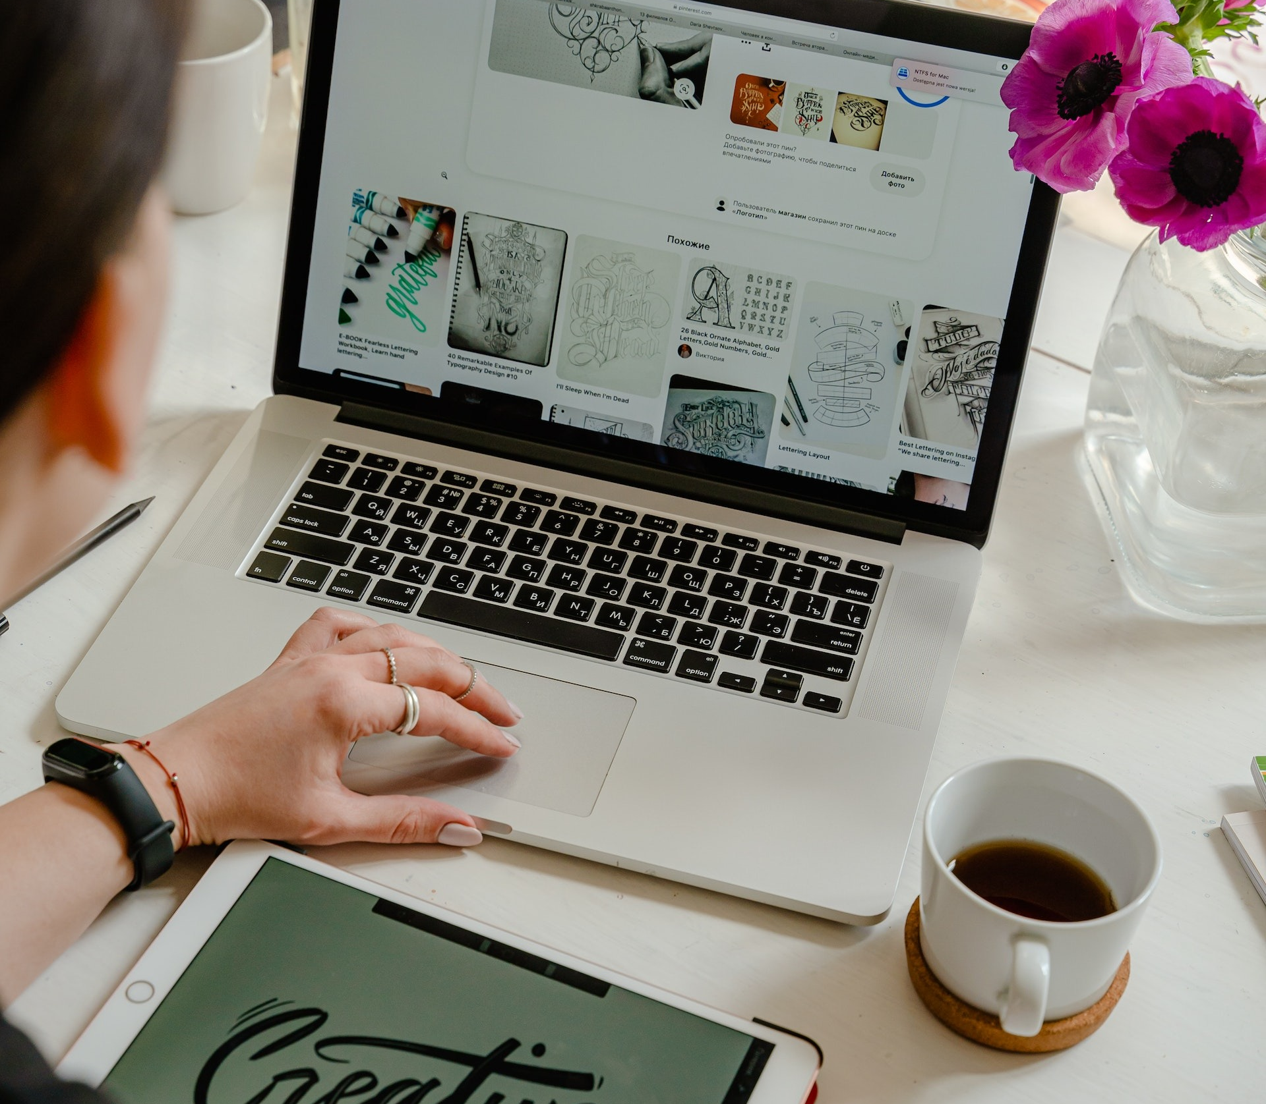
Managing Digital Distraction
One of the best ways of managing digital distraction is to temporarily disconnect from technology, which leads to fewer digital distraction.
While the ability to multitask is seen as a positive trait for many, it is also a major source of digitally-induced stress that can be controlled, once we have gotten into the habit of taking breaks.
Once we’ve started to see the difference unplugging from devices makes, we might want to swap our constant news feed swiping and reactions to notifications to embrace a life that’s free of digital distractions.

Slide 29

What is an Attention Span?
Your Attention span is the time you can focus on a task before you feel you need a break or get distracted.
This amount of time can vary on the person. It is difficult to pin down an exact amount of time for each person’s attention span, as it can depend on the complexity of the task, and the natural cognitive abilities of each person.
Check out the following slide for some tips on how to improve your attention span whilst using digital technologies.

Slide 30

Improving Your Attention Span
These are few suggestions on how to increase your attention span:
Practice attentive listening. One way we can stretch and hone our attention span is to practice active, attentive listening. This helps focus the mind’s ability to receive and absorb information.
Devote more time to reading. Another way to hone our mind’s ability to concentrate is by attentive reading. ...
Physical activity. One other way to increase our attention span is to get moderate levels of exercise.

Slide 31
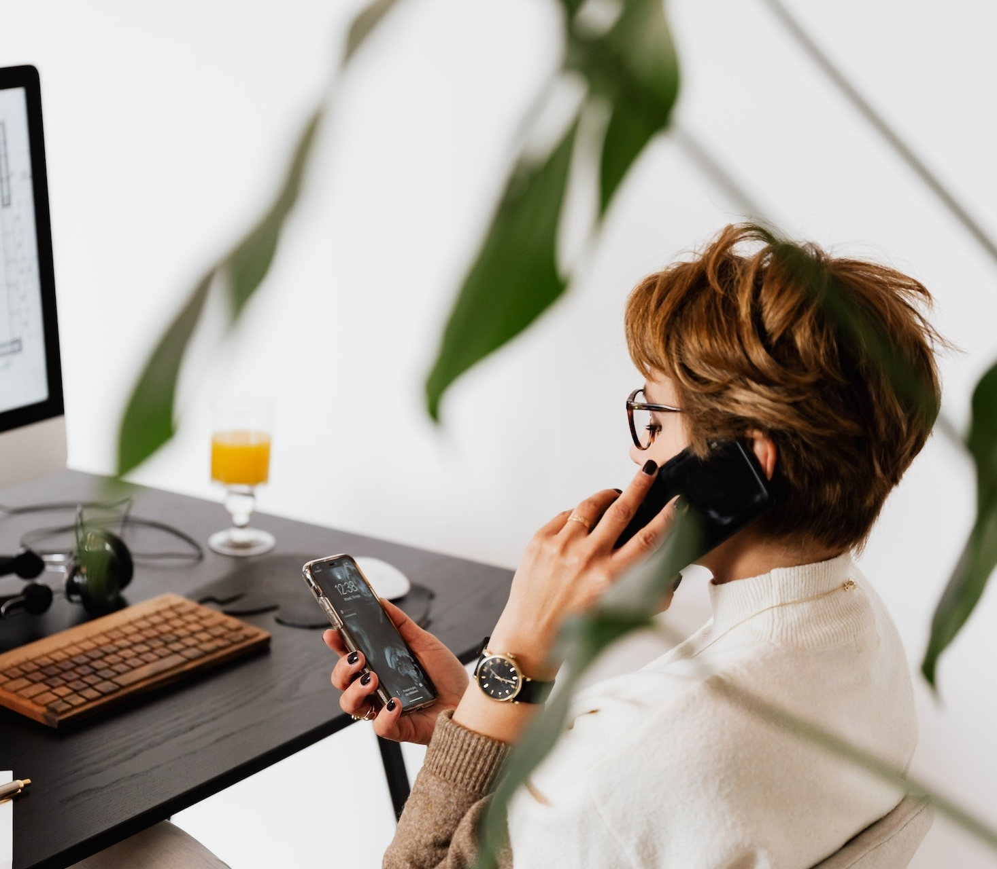
Multitasking
Multi-tasking seems like a great way to get a lot done at once, but research has shown that our brains are not nearly as good at handling multiple tasks as we like to think they are.
In fact, some research suggests that multi-tasking can hamper our productivity by reducing our comprehension, attention, and overall performance.
People who multitask are more distractible, and they may have trouble focusing their attention even when they're not working on multiple tasks at once

Slide 32
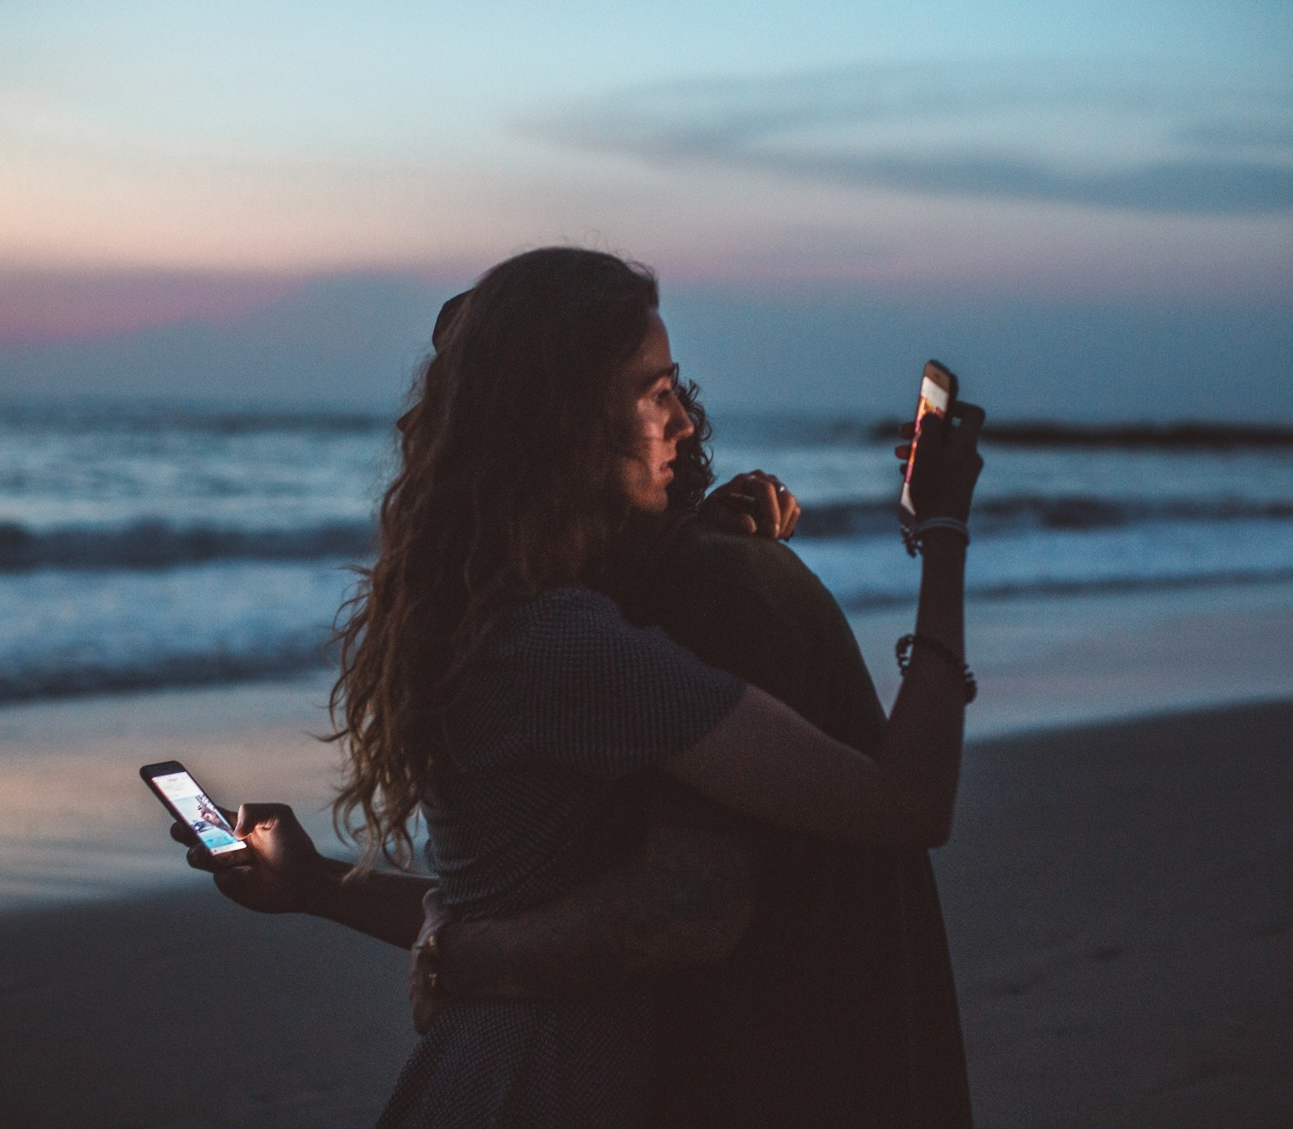
Tips For Multitasking
Follow these simple steps to make multi-tasking less stressful:
Do one task at a time
Don't start on a second task before the first one is completed
Start with the simple and short things first
Stay away from phone while doing something else, or keep it silent
Monitor your stress levels and take a break when needed

Slide 33
Wondering If You Are Digitally Burnt Out?
There are several questions you can ask yourself when trying to work out how digitally burnt out you may be. Ask yourself:
How satisfied are you with the amount of control and involvement you have with the digital devices you use?
Do you spend a lot of time surfing the internet or online shopping?
Do you feel burnout, but you are unsure why?
Does you get frustrated when someone disturbs you when you are on a device?
Do you feel tired a lot of the time?
Do you find that you are up late because of using digital devices?

Slide 34
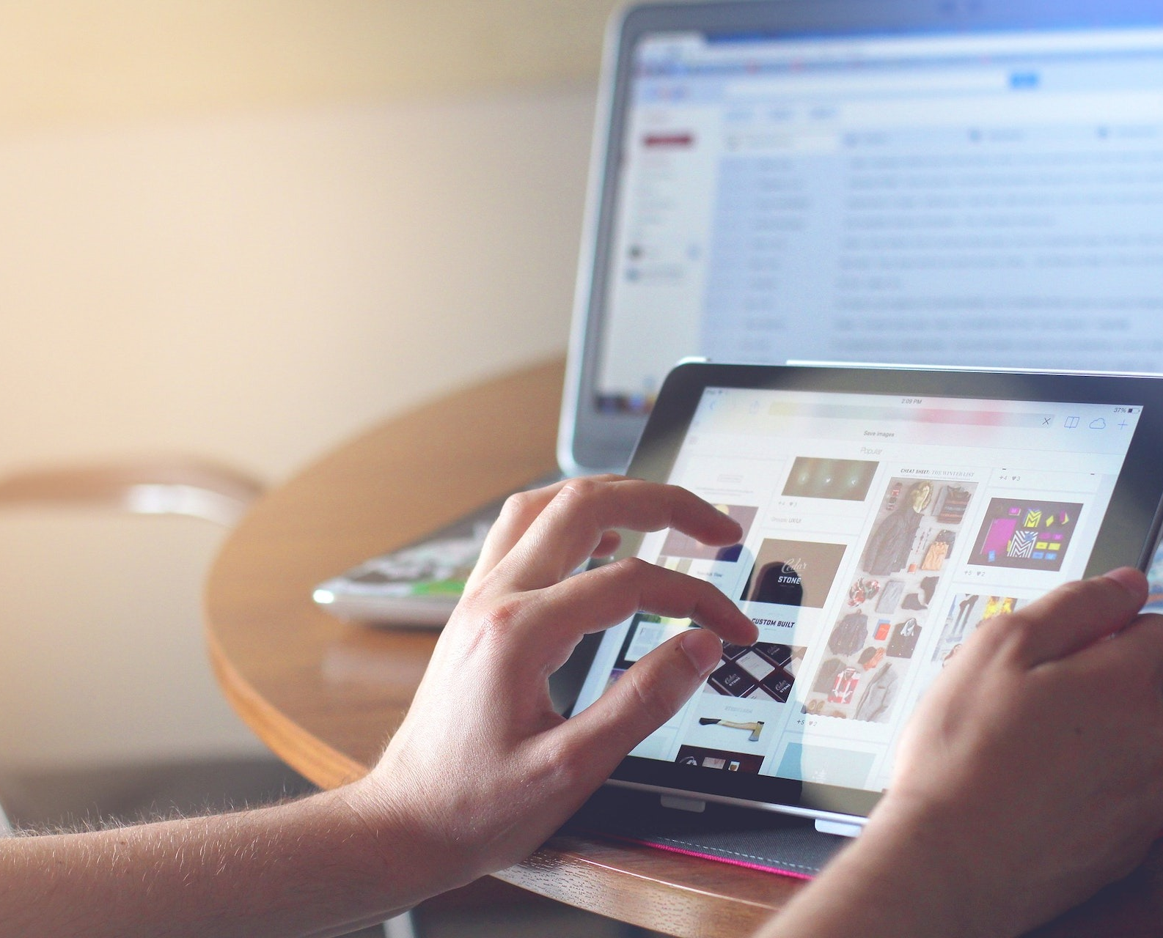
Exercise- Take a Digital Burnout Test
If you answered “yes” on several of the questions in the previous slide, you might be at risk of suffering from digital overload or technostress!
Try taking this quick survey to help analyse your stress levels:
https://www.mindtools.com/pages/article/newTCS_08.htm

Slide 35
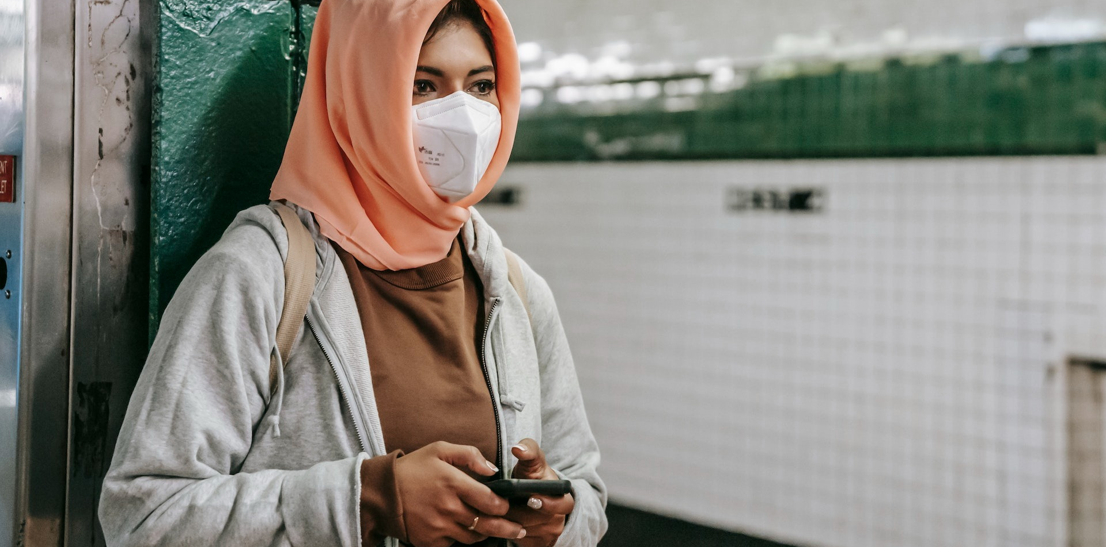
Topic 3: Protecting Devices

Slide 36
Relevant Definitions
Before we begin topic 3, here are some useful definitions to help you understand
some of the information in this module.
Internet security is a term that describes security for activities and transactions made over the internet.
Hacking is where unauthorized users gain access to computer systems, email accounts, or websites.
Viruses or malicious software (known as malware) can damage data or make systems vulnerable to other threats.
Identity theft is where criminals can steal personal and financial information.

Slide 37

Your Phone is more than a Device!
As a migrant woman, it is likely that your phone is more than just a device you use. For many of us, our phones allow us to connect with family and friends at home through various chats, groups and social networks.
Many of us also use our phones to take pictures and record parts of our lives, and we would be lost without it.
Your phone can store enormous emotional value, lets see how to protect it and other devices that you own!

Slide 38
TASK
The following 5 slides are a step-by-step guide on online security.
Research each topic and follow the given links.
Print the next 5 slides and talk about them with your family or friends that are good with digital technology.
Try to implement some of these tips over the next 6 months.

Slide 39
Securing Your Wireless Router
These are a few steps you can do to set up your router and get better security:
Change the name of your router:
The default ID – Change your router name (SSID) to a name that is unique to you and won’t be easily guessed by others. Click on the link above on how to do this yourself.
Change the preset passphrase on your router:
Leaving a default passphrase unchanged makes it much easier for hackers to access your network. You should change it as soon as possible. A strong passphrase is a sentence that is at least 12 characters long. Click on the link above on how to do this yourself.
Review security options:
When choosing your router’s level of security, opt for WPA2, if available, or WPA – these levels are more secure than the WEP option.

Slide 40
Securing Your Wireless Router
Create a guest passphrase:
Some routers allow guests to use networks via separate guest passphrases. If you have many visitors to your home, it’s a good idea to set up a guest network.
Use a firewall:
Firewalls help keep hackers from using your device to send out your personal information without your permission. While antivirus software scans incoming emails and files, a firewall is like a guard, watching for attempts to access your system and blocking communications with sources you don’t permit. Your operating system and/or security software likely comes with a pre-installed firewall, but make sure you turn on these featues.

Slide 41
Protecting Your Digital Privacy
If you are not a person with strong pc background and network skills, still you can do something to protect your digital privacy without huge knowledge about network security. Here are tips on how to keep your personal information secure online:
Think before you share
Everything you share online goes beyond your control — whether it’s a password, kid’s photo, or a late-night philosophical thought. Take a moment to consider the risks of sharing too much.
Lock your devices and cover your cameras
Don’t underestimate simple solutions when it comes to your privacy.
Use a VPN and security software
(A virtual private network, click on the link to find out more)

Slide 42
Protecting Your Digital Privacy
Use unique, strong passwords and enable two-factor authentication, where possible.
The extra effort is justified when you want to protect your accounts from hackers or thieves.
Review privacy policies and app permissions
Check out the latest information about the way your personal data is collected and used. On your phone and tablet, review the apps’ access permissions and turn off anything you deem excessive.
Secure your smart devices
Make sure your home network and gadgets are protected by unique, strong passwords.
Check your data breach status regularly: https://www.f-secure.com/en/home/free-tools/identity-theft-checker

Slide 43
Protecting Yourself With These Online Tips
Protect your €€:
When banking and shopping, check to be sure the sites is security enabled. Look for web addresses with “https://,” which means the site takes extra measures to help secure your information. “http://” is not secure.
Back it up:
Protect your valuable work, music, photos and other digital information by making electronic copies of your important files and storing them safely.

Slide 44

Securing your home network
A protected home network means you can use the internet more safely and securely.
Most households now run networks of devices linked to the internet, including computers, gaming systems, TVs, tablets, smartphones and wearable devices that access wireless networks. To protect your home network, you need to have the right tools in place.
The first step is to keep a clean machine and make sure all of your internet-enabled devices have the latest operating system, web browsers and security software. This includes mobile devices that access your wireless network.

Slide 45

Topic 4: Protecting the environment

Slide 46
Relevant Definitions
Before we begin topic 4, here are some useful definitions to help you understand some of the information in this module.
Digital pollution includes all sources of environmental pollution produced by digital tools. It is divided into two parts: the first is related to the manufacture of any digital tool, and the second to the functioning of the Internet.
e-Waste is electronic products that are unwanted, not working, and nearing or at the end of their “useful life.”

Slide 47
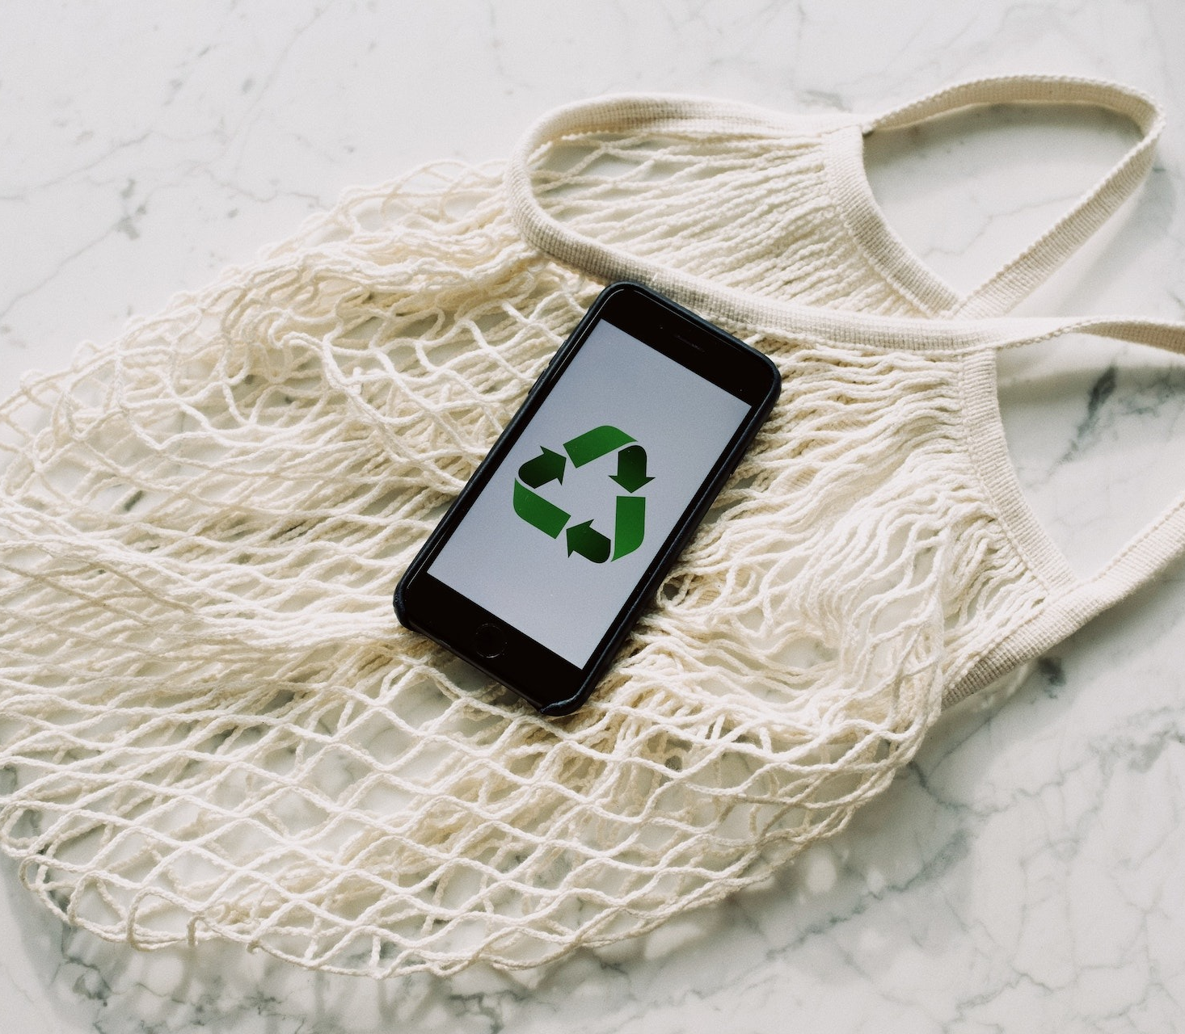
Environmental Impact of Technology
We often presume that digital technology is not having much of an affect on our planet, but in reality, technology when not managed well has significant damaging impacts on the environment.
Let’s take a look at the following 4 aspects of digital technologies environmental impact:
The end of a device's lifespan
How much electricity is too much electricity?
What is your device made of?
Impact of technology on space and outer space

Slide 48
The End of a Device’s Lifespan
Unsustainability and devices becoming outdated or redundant comprises of a core part
of the technology business model. At least three key issues can be noted here:
Replacement Rather Than Repair
Most of the sector is based on the concept of replacement rather than repair. This years’ technology rapidly becomes outdated, and generally people replace their phones every two years. New models come out and new fashions are promoted.
Software Development Forces Hardware Upgrades
The hardware-software development cycle forces users to upgrade their equipment on a regular basis. This sometimes means that devices might run slower, or battery life isn’t as good as it once was.
The Growing e-Waste Problem
Much e-waste contains concentrated amounts of potentially harmful products, and this shows little sign of abating.

Slide 49
How Much Electricity is Too Much Electricity ?
Digital technology must have electricity to function and as industry and society become increasingly dependent on electricity for production, exchange and consumption, the demand for electricity continues to rise.
Four interconnected examples can be given of the scale of this environmental impact on climate change.
Electricity for Manufacturing Devices
Much more electricity is often consumed in manufacturing digital devices than in their everyday use.
Electricity for Digital Technology Use
Most measures of electricity demand focus on the direct uses of digital technology, such as powering servers, equipment and charging mobile devices (phones, tablets, and laptops), but indirect demand must also be recognised, notably the air-conditioning required to reduce the temperature of places running digital technology.

Slide 50
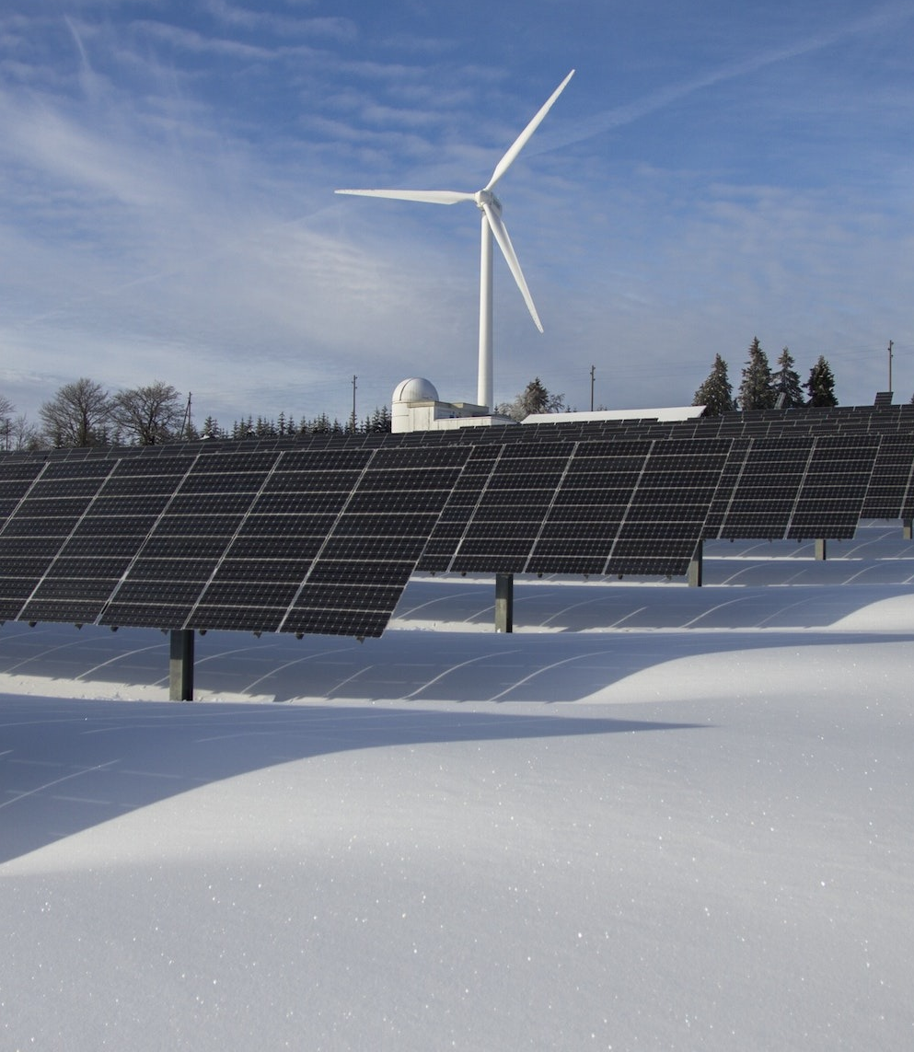
How Much Electricity is Too Much Electricity?
Electricity for New Digital Technologies
Specific new technologies, notably blockchain and cryptocurrencies, have been developed with little regard for their electricity demand and thus their environmental impact. For example, Bitcoin mining could be consuming the same amount of electricity every year as is currently used by the entire world.
Electricity for 5G and Internet of Things
Future projections relating to Smart Cities, 5G and the Internet of Things also give rise to additional concerns over energy demand. 5G, for example - the necessary denser networks - will place much heavier demands on electricity unless more energy-efficient technologies are put in place, especially as electric vehicles become more popular.

Slide 51
What is Your Device Made of?
The exploitation of many rare minerals is not sustainable environmentally and is frequently
based on labour practices that many see as lacking moral integrity. There are two aspects that are important here:
Need for Rare Minerals
Most digital technologies rely on rare minerals that are becoming increasingly scarce. Many people are unaware, for example, that a mobile phone contains more than a third of the elements in the Periodic Table. Minerals such as Cobalt, the 17 rare earth elements, Gallium, Indium and Tungsten are becoming more and more in demand, and as supply is limited prices have often increased significantly.
Mining Rare Minerals
The actual exploitation of such resources is often hugely environmentally damaging. Mine tailings, open cast mining methods, and waste spillages are all commonplace.

Slide 52

Impact Of Technology On Space and Outer Space
Electrical Demand of New Technology
The renewable sources of energy would undoubtedly reduce the carbon impact of digital technologies, but their negative side-effects must also be taken into consideration. Digital technologies are crucial for smart motorways and self-driving electric cars. The shift to renewable production will lead to a very significant environmental impact through the construction of wind turbines and solar farms.
For example, wind farms would need to cover the whole of Scotland to power Britain’s electric cars

Slide 53
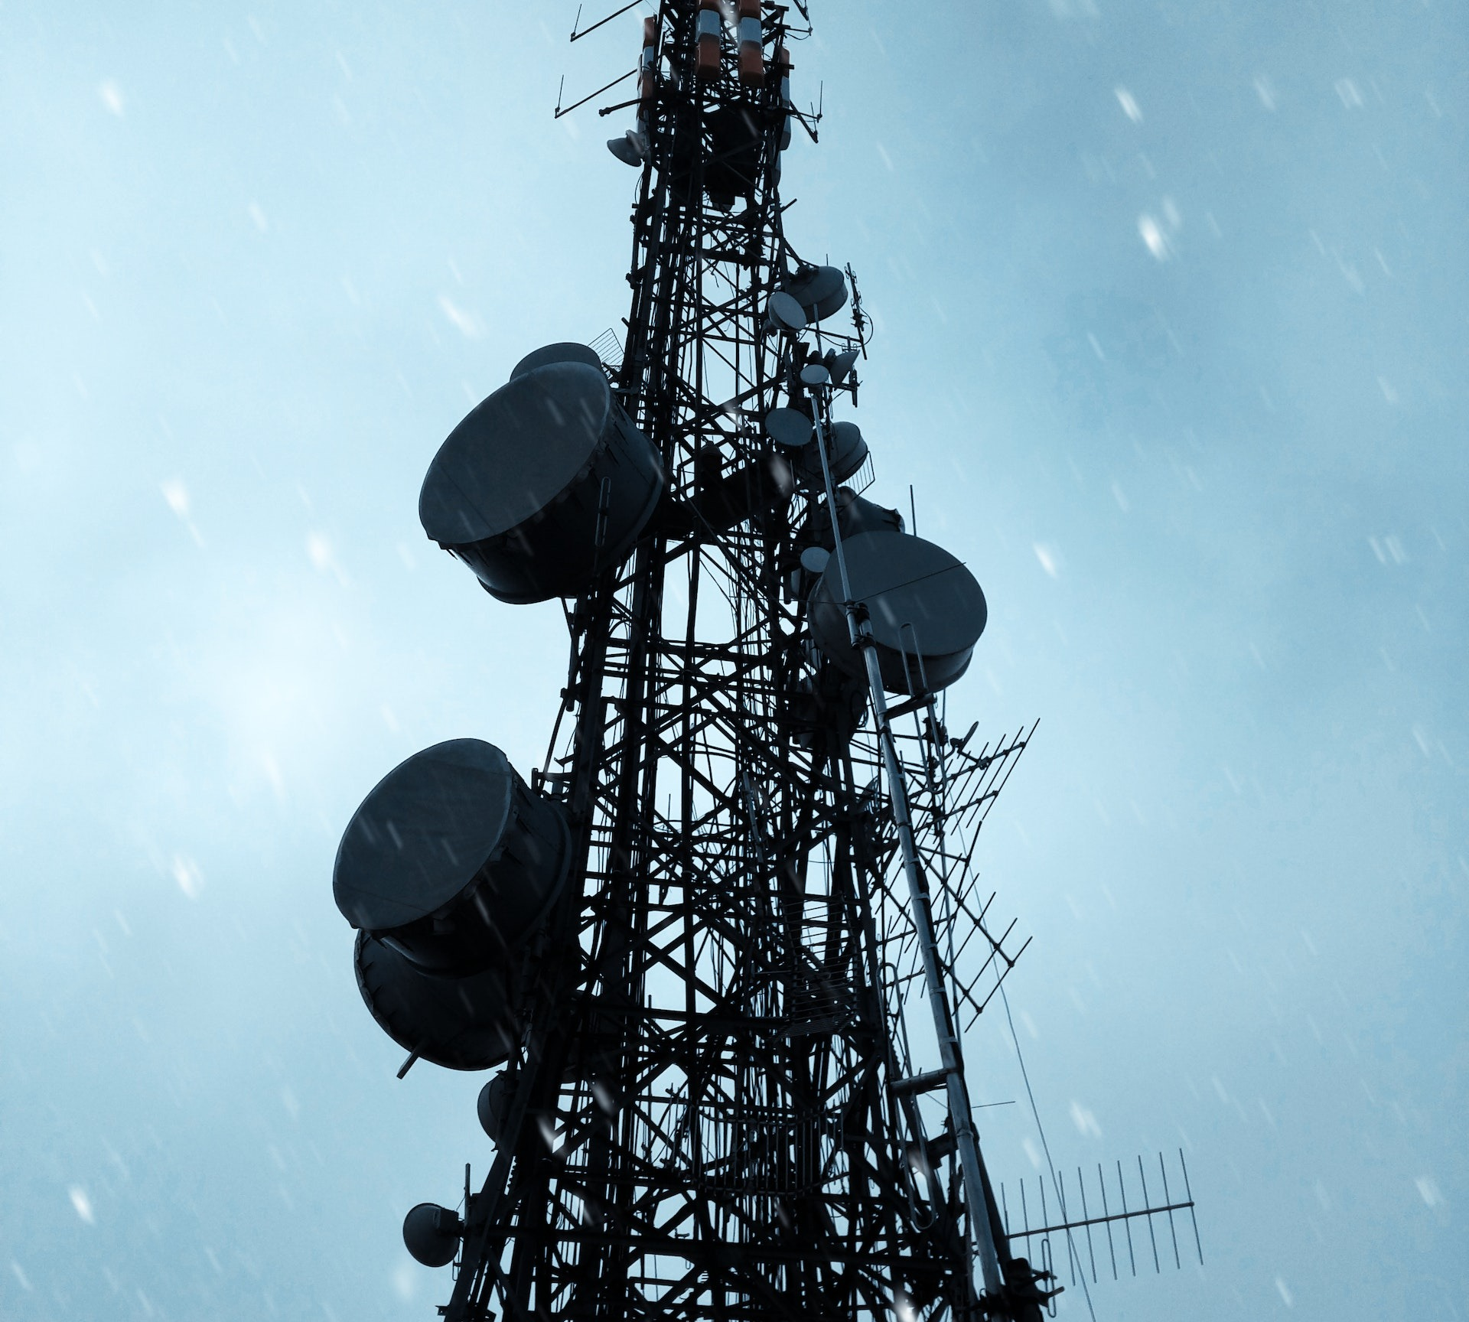
Impact Of Technology On Space and Outer Space
Expanded physical infrastructure
The impact of a large number of new cell towers and antennae that will be needed for 5G networks, as well as the buildings housing server farms and data centers also have a significant environmental impact.
It is not just the electricity demands for cooling that matter, but the sheer size of data farms also has a significant physical impact on the environment. The average data center covers approximately 100,000 sq ft of ground.

Slide 54

Impact Of Technology On Space and Outer Space
Proliferation of Satellite Constellations
Space is seen as having no relevance for environmental matters, rather like the oceans, but in reality, space pollution is very important to us.
The environmental impact of rockets that launch satellites into space has until recently scarcely been considered. It is estimated that there have been about 8,950 satellites launched into space of which around 5,000 were still in space, with only 1,950 still functioning.
SOURCE

Slide 55

Watch- The Ecosia Search Engine
We can all do our bit to help the environment and contribute to the impact of our digital use. One way we can combat our impact is by using the Ecosia search engine instead of Google.
Ecosia plants trees every time you use the website to search for something! Check out the video opposite for more information about Ecosia.
Click here for a link to the Ecosia website
Video Link:
https://www.youtube.com/watch?v=yRDA1ynrHTU

Slide 56
End of Module 4
Thank you for reading Module 4, and we hope you have enjoyed it and learned some useful information.
Module 5 of the Teach Digital OERs is titled “Problem Solving”. Here, you will find more information on the following topics:
Topic 1 - Identifying Needs and Technological Responses
Topic 2 - Solving Technical Problems
Topic 3 - Creatively Using Digital Technologies
Topic 4 - Identifying digital competence gaps

