Slide 1
Module 2
Communication and collaboration

Slide 2
Module 2 Overview
Within Module 2 you will learn how to interact through a variety of digital technologies.
You will gain an understanding of how to communicate well digitally, making reference to tone and other things that might get misunderstood when communicating online.
Learn how to share data, information and digital content with others through appropriate digital technologies;
Understand acting as an intermediary;
To participate in society through the use of public and private digital services;
To seek opportunities for self-empowerment and participatory citizenship through appropriate digital technologies
Interacting and sharing through digital technologies
Engaging in citizenship through digital technologies
Collaborating through digital technologies
Netiquette and managing your digital identity

Slide 3

Topic 1 - Interacting and sharing through digital technologies

Slide 4
Paying attention to tone
When we communicate with one another online, it can be a very different experience than when we communicate with each other in real life.
When we communicate with people in real life, you can see them, see their facial expressions, hear their tone of voice, see their body language and hand gestures.
When we communicate with people online, many of these visible ques are lost. This means it can sometimes be hard to understand what someone is trying to say, especially when there is a lack of tone too.
For example, using cap locks may come across as overly aggressive, as if you are nearly shouting.
Let’s take a closer look at the next slide

Slide 5

Workplace examples
But what about when looking for work? How could something as simple as communicating using caps lock send the wrong message?
If you emailed a potential employer using the wrong tone, you may come across as someone who is unprofessional.
For example, using caplocks or emoticons during a job application may make it look like you are not taking the application seriously, or that you might seem less professional than you are.

Slide 6
Tips to improve tone when communicating online
Avoid negative words. By using negative words, you might cause the reader of the message to think you are feeling a certain way when you aren’t. it is best to try to stick to positive words to achieve this.
Avoid emoticons. Emoticons are symbols that are used to convey feelings over text. For example ☺ is a smiley face emoticon. Generally, these are used in an informal way, so ideally, in a workplace setting it is recommended to not use them.
Avoid text speak. Text speak is where words might be shortened, such as LOL for laugh out loud, or l8r for later. Similar to emoticons, this type of language is seen as unprofessional and casual.

Slide 7
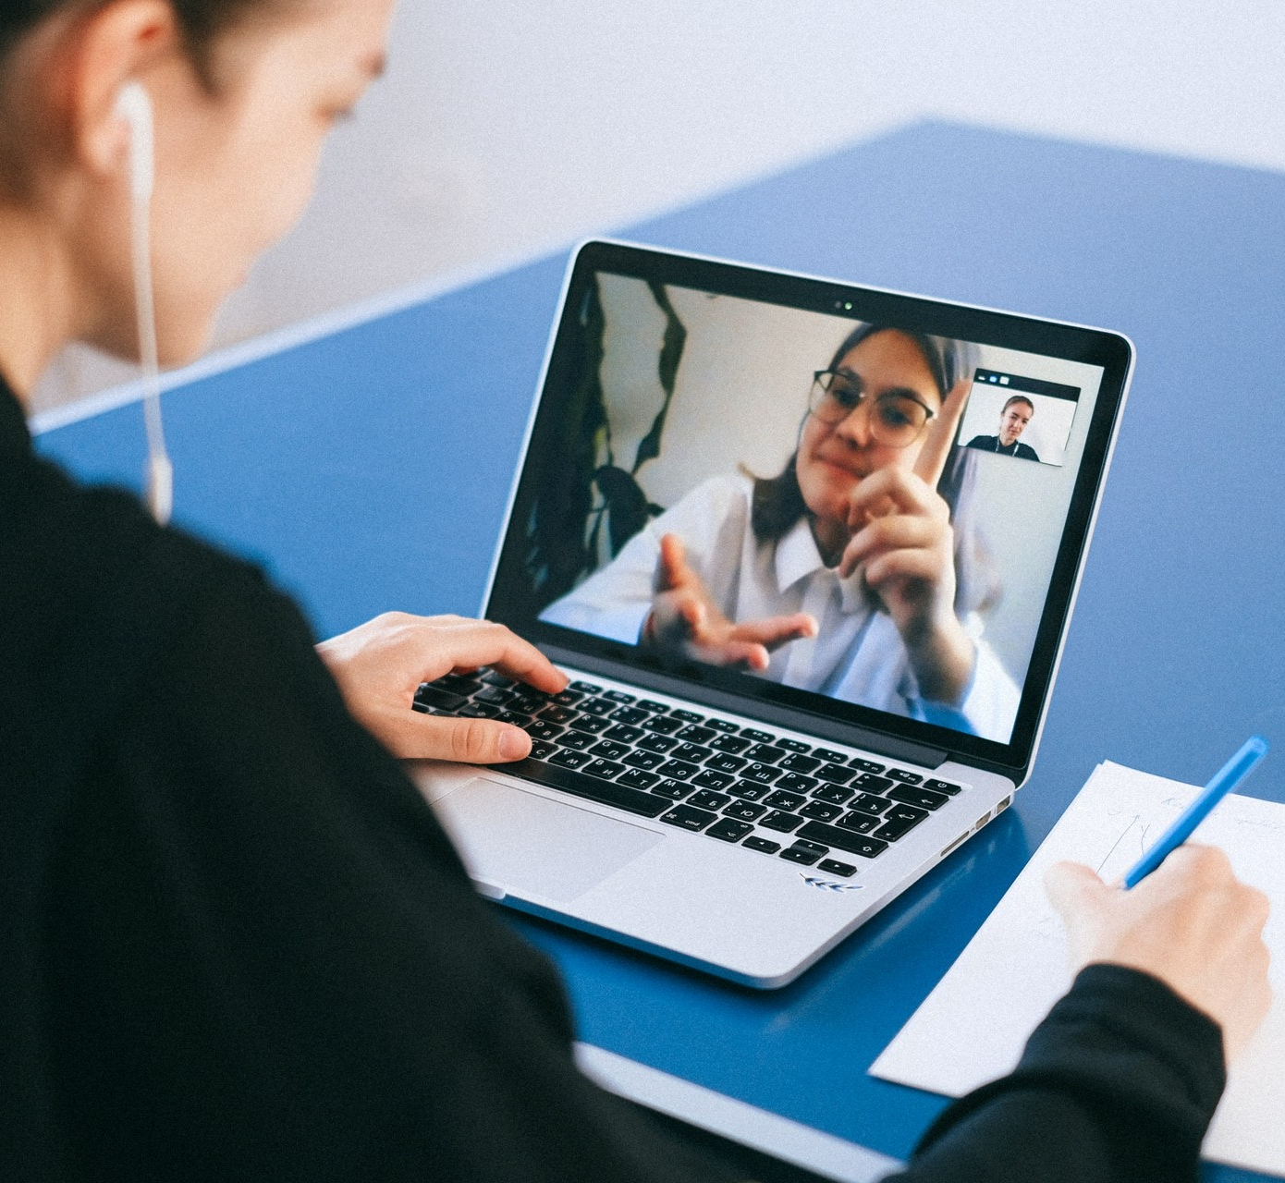
Types of Communication
There are two main types of communication.
Synchronous communication occurs at the same time (real-time) but in different places. A telephone is an example of synchronous communication. Other examples include chat, video conferencing, Skype, Zoom and an online whiteboard. You may be accustomed to using some of these tools to communicate with friends and family outside an educational setting.
Usually, this type of communication requires notice between users and isn’t spontaneous. For example, you would agree a time with someone if they were giving you a job interview through Zoom.

Slide 8

Types of Communication
When you communicate at different times and places to other people, usually at your own convenience rather than real -time, this is known as Asynchronous Communication.
Asynchronous activities allow each voice to be heard, whether you are participating in a small or large group.
Tools that you can use for asynchronous communication can include e-mail and discussion forums. You might also use social media websites such as Facebook, Twitter, or blogs.

Slide 9
Tips For Communicating in Forums
Forums can be very useful for gathering information around specific jobs and what the organization might be like to work for. Each country will have a different forum related to information about that country.
For example, within Ireland there is a website called Boards.ie. This website is great for general information, but is also particularly useful when applying for jobs as you can ask people for their advice and their experiences.
When you are new to posting on a forum, try writing your answer in Word and then copying and pasting it into the discussion board. This is useful for proof reading and making sure you aren’t making any spelling or grammatical errors, but it is also useful incase something happens to the website (for example it crashing) and you end up losing your answer.
While discussion boards should include proper use of grammar and spelling it is important to remember that you can share personal experiences and be a bit more informal when talking to others- your tone doesn’t always need to be professional.

Slide 10
Tips For Communicating Through Email
Remember to use subject lines and make sure they are relevant and accurate to the email. For example, if you were applying for a job in the Civil Service, it would be a good idea to refer to it as “Civil Servant job application” rather than “Your Name CV”.
Remember to structure emails well. Use paragraphs regularly. If you need to create a list, use bullet points. Keep an email as short as you can.
Try and keep your emails professional when they are in a professional setting. Make sure your tone of writing matches who you are writing to. Try not to use too many Exclamation Marks or Emojis.
Always proofread your emails before sending them. Similar to the previous tip of writing in a forum, it can be a good idea to write your email in word and copy and paste it into your emails then.
Never send an email when angry or frustrated. Try and cool down before responding to an email that might have upset you.

Slide 11
Tips For Communicating Virtually
In virtual communication, we tend to be more prone to judgements. It’s easier for our brains to create negative narratives about a certain situation happening in a virtual conversation. This is often because we don’t see peoples faces (if an exchange is in writing), or we don’t know the person enough.
Here are some tips to avoid virtual communication falling into negativity:
Be flexible – meetings, camera off/on, styles of expressing thought, this can all differ from person to person, day to day, and that is still ok
Be intentionally empathetic – try putting yourself in another person's shoes before replying
Ask questions – try to understand the other point of view, but be subtle
Be forgiving – your peers or lecturers are just people, just like you
Build relationships – each communication is a chance for a long-lasting connection

Slide 12

Visual Literacy
What is visual literacy?
Visual Literacy practices equip people with the required skills, abilities and knowledge for enhancing their problem-solving capabilities, as well as fostering creative thinking and innovative skills.
People who have good visual literacy can become better at communication in a visual environment.
Visual Literacy can be very useful in jobs where you need to make posters or advertisements, especially for sharing information for facts about something you want to promote.

Slide 13

Tool Deep Dive: Thinglink
Thinglink is tool that allows educators and students embed audio, video and rich media links directly in images and share them across the web, and is simple to operate. Thinglink encourages interactive thinking and collaboration. In a professional setting it can be easily incorporated into group work.
Thinglink can be used to designate parts of sites or pages with pictures and videos that will produce a pop-up with a description and or a link to something else on the web when they are scrolled over. Users can make static images interactive which can make learning more engaging.
Tool Website: Seamlessly make your images, videos, and 360 content interactive with Thinglink

Slide 14
Pros & Cons of Thinglink
Pros for Thinglink:
Simple and easy to use, small learning curve
Analytics are provided to assess how
Can be used to easily create engaging content
Cons for Thinglink:
Login is required to access Thinglink
Students cannot directly add comments to a post, comments must be created on a social media platform first

Slide 15



Video: Introduction to Thinglink
Check out this handy video which explains how to get started with using Thinglink:
https://youtu.be/iaZZfECX4p0
Click to watch

Slide 16

Tool Deep Dive: Padlet
Padlet is an online noticeboard, which can be used for making announcements, keeping notes and online brainstorming. Notes can contain contain links, videos, images or document files. When registered with Padlet, one can create as many “walls” or online notice boards as you like.
As a creator of a wall, you can moderate all notes before they appear, and privacy settings can be adjusted at any time. Padlet is great for group research, as it allows people to share their ideas with each other encouraging creativity. By using Padlet it can help to increase your visual literacy. You can also use Padlet as a way of sharing links or information conveniently.
Tool Website: Padlet: You are beautiful

Slide 17
Pros & Cons of Padlet
Pros for Padlet:
No account is required to use Padlet
Fantastic engagement and collaboration tool, improving teamwork and co-operation
Has privacy settings so that you can either have your board open so anyone can view it, or private so only your class can view it
Cons for Padlet:
Some users report technical issues, such as links breaking or users being unable to view Padlets
Padlet does require internet access to use
Can take a little time to fully learn the software

Slide 18

Video: Introduction to Padlet
Check out this handy video which explains how to get started with using Padlet:
https://youtu.be/UkBnwPqaIjA
Click to watch

Slide 19
Exercise / activity - Jitsi.meet
Click on the search engine jitsi.meet, and access their website
When you open the web page, a screen with a link and a calendar will appear.
To reserve a room to start a meeting, it is necessary to name it with a name that allows it to be identified. It is preferable to indicate a specific name, in order to avoid common names, so that anyone can access it. Once the name is indicated, click on the link to access the room.
Before entering the 'meeting room' you will be given the option to activate the camera, microphone, set a wallpaper, configure certain settings and invite additional participants.
Once you have made all these settings, you will enter directly to the meeting room, after clicking on the link 'enter meeting’.
You are already inside the meeting... so enjoy and share information with your friends or colleagues!

Slide 20

Topic 2: Engaging in citizenship through digital technologies

Slide 21
Relevant Definitions
Before we begin topic 2, here are some useful definitions to help you understand some of the information in this module.
Digital Citizenship- this is when a person engages and acts responsibly to continuously be involved in community life. Such engagement depends on contextual, informational and organizational criteria that constitute the guiding principles underpinning the societal and educational progression towards digital citizenship.

Slide 22

Why is Digital Citizenship Important?
Digital Citizenship teaches you how to live in the digital world safely, responsibly, and ethically.
Although digital citizenship potentially begins when any child, teen, and/or adult signs up for an email address, posts pictures online, or uses e-commerce to buy merchandise online, the process of becoming a digital citizen goes beyond simple Internet activity.

Slide 23

Being Online: Access and Inclusion as well what it means to be a digital citizen
Click + CTRL on the image on the right to read about what it means to be an active digital citizen.
The resource is a handbook by Janice Richardson and Elizabeth Milovido for the Council of Europe and explores digital citizenship deeply.
Click to read

Slide 24

Click to watch
Watch the Video:
Migrant Women & New Technologies
Take a look at the following video which is a Huawei Women Power Talk by Anila Noor. The speaker discusses how technology can help migrant women become active participants in their country’s societies.
https://youtu.be/yIhXda7383g

Slide 25
Four Ways to Improve Digital Citizenship
Using technology to make your community better. There are many ways that we can do this. It can be simply to help other people gain digital skills within your community, or it can be to help link people up in your community with resources and advice that they may need. There are many apps available to help you do this. Try going onto the Citizen’s Lab website to see some ideas for yourself that you may be able to implement in your own local community.
Engaging respectfully online with people who have different beliefs than you. We have seen throughout Module 1 that sometimes when we communicate with people online that there are a lot of factors involved. It is important to acknowledge that because you can communicate with so many people online you will come across many people who do not share the same beliefs as you. It is important to converse with people online respectfully and allow everyone their own opinion.

Slide 26
Four Ways to Improve Digital Citizenship
Using technology to make your voice heard by public leaders and shape public policy. Is there something that you feel your community should be doing or there is something that you wish you could change about your area? You can use technology to make your voice heard quite easily. Firstly, raise attention to the issue, and highlight it to politicians or community leaders that can make a difference. Many of them will have public social media accounts that you can use to help draw attention to an issue. Social media is also a great resource to find like minded people. Try creating a social media group for your local area to help find people who will aid you in your journey.
Determining the trustworthiness of online sources of information. As we saw in Module 1, it is important to not believe the first thing you read. When you come across some information, try to fact check it. You may wish to Google about the information or use a different search engine to find out about it. If you know someone who is an expert in that area, or may know something about it, you could also ask them.

Slide 27

An Example of Digital Citizenship
In 2020, the Covid-19 pandemic shook the world. As countries throughout the world rushed to find solutions to the pandemic, the Covid-19 vaccine was created to help battle the virus.
Many countries throughout the world felt that if you were vaccinated against Covid, you should be able to travel freely, like before the pandemic. The question was how can we tell if someone is vaccinated and someone isn’t.
In the EU, we created a Digital Covid Certificate. Over the next few slides we will look at how the Covid Cert relates to Digital Citizenship

Slide 28
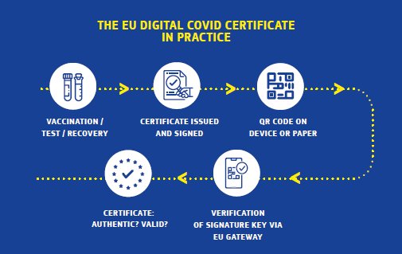
The EU Digital COVID Certificate
Serves as a proof that a person:
has been vaccinated against COVID-19, or
has received a negative test result, or
has recovered from COVID-19.

Slide 29
Let’s think about how digital citizenship and the example of the EU Digital COVID Certificate correlate
According to the article published on MEDIA.COM, by Paolo de Rosa
Digital integration, the key to a united Europe:
Thanks to technology, an innovative collaboration was substantiated at the European level, where digital tools were used to solve a cross-border problem
Digital innovation has helped to shape the idea of European integration in new ways. Cooperation in the field of health for the development of interoperable eHealth solutions is a first step in the construction of a European digital identity.
The future of digital identity, the key to accessing digital public services, is the new test to assess the validity of the path traced in recent months. Recently the EU Commission showed the way with the prospect of every EU citizen and resident being able to use a personal digital ‘wallet’ in the future.

Slide 30
Case Study - Communication During the Pandemic
Sometimes it can happen that distance prevents regular contact with family and/or friends... but also the fact of meeting in person for a job interview, due to physical distance, economic resources, difficulty in reconciling travel time and/or housework, etc. But how can this problem be solved?
The solution is to use applications that allow you to have virtual meetings, such as Jitsi.meet. This can be used to with a computer or cell phone. People will acquire skills to quickly solve a problem of organizing a meeting.
If you have the skills to organize a meeting on the computer or using the cell phone, you don't need to spend money going to a far away place. This knowledge will save you time and reduce your isolation.
Translated with www.DeepL.com/Translator (free version)

Slide 31
Case Study - Communication During the Pandemic
For Parveen, she came across several difficulties with being able to communicate with people during the pandemic. Initially, it was communications with her friends and family when there was a full lockdown so she was unable to meet them in person.
She ended up using the virtual meeting app Jitsi.meet to avoid this. This applicated enabled her to host a virtual meeting room so that other people could join her, and she said that it was a fantastic social experience, as it helped to alleviate her loneliness that she had experienced during the lockdown.
However, as time progressed she also found that the knowledge of being able to use the app helped her professionally. She attended an interview that was hosted virtually through the app, and claims that her being hired was partly because she was confident using the software. To find out more about jitsi.meet, click on this link.

Slide 32
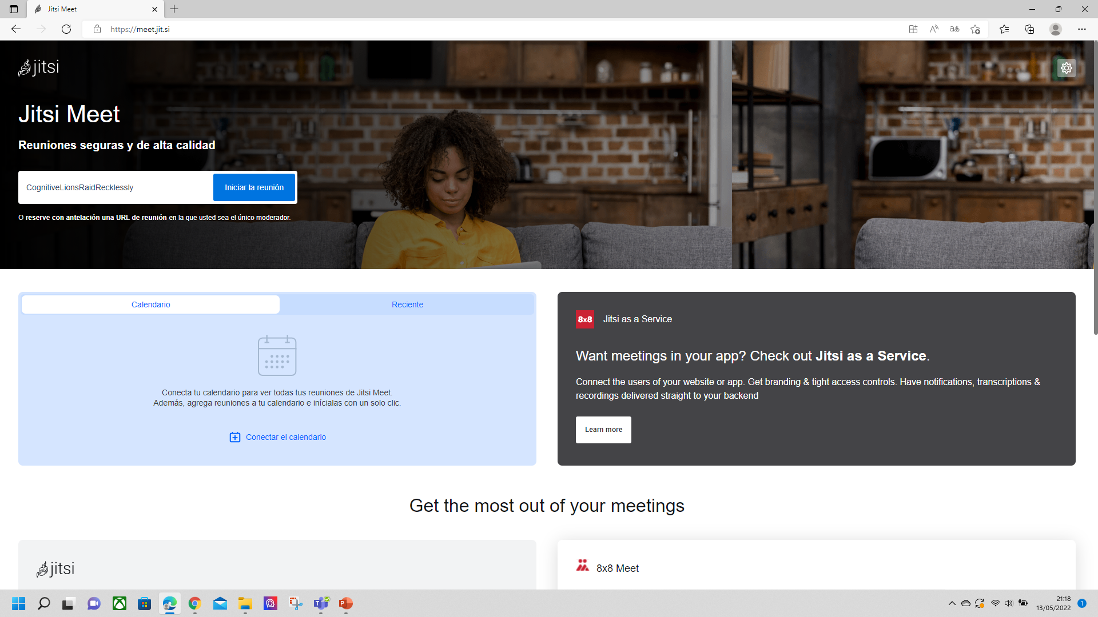
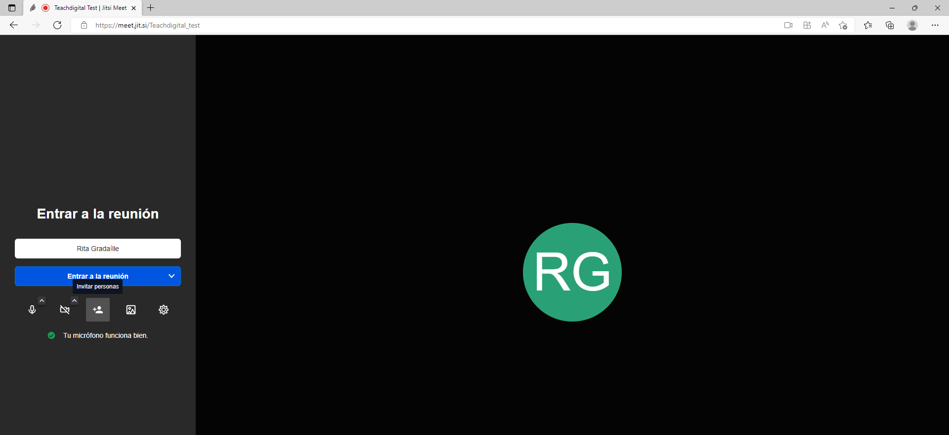

How to start a virtual meeting?
To start a virtual meeting, you have to indicate a specific name. Once the name is indicated, click on the link to access the room.
First steps to start a virtual meeting in Jitsi.meet:
Before entering the 'meeting room' you will activate the camera, microphone, set a wallpaper, configure certain settings and invite additional participants.

Slide 33

Topic 3: Collaborating through digital technologies

Slide 34
Relevant Definitions
Before we begin topic 3, here are some useful definitions to help you understand some of the information in this module.
Interaction is communication or direct involvement with someone or something. It can provide learners with the opportunity to communicate during the event amongst themselves and with the facilitators, often through technology. We can use chat, emoticons, polls, whiteboards, breakout rooms, application sharing, and web browsing.
Learning happens during collaboration. It allows our learners to build on baseline information that they may have gotten through course content, like readings or videos. Learners get to practice through collaborating. It can enable learners to think in higher-order thinking such as problem-solving.

Slide 35

Collaborating With Digital Technologies
There are many ways that we can collaborate using digital technologies. Throughout this topic we will identify several different digital tools that can be used to help you collaborate with people online.
Collaboration online can be done in many different ways, such as several people working on documents together simultaneously, brainstorming or coming up with ideas, connecting and networking with other professionals and even creating notes together.

Slide 36

Tool In Focus: Google Suite
The Google Suite is comprised of many tools, but the three best for collaborating with are the three main document tools- Google Docs, Sheets, Slides, Forms and Google Sites. Within these you can work together with people in the same document in real-time. Commenting on any file brings a conversation into context so you avoid back-and-forth email and lost time. You will also be able to see what edits have been made by each person, and files save automatically.
Just click “New” and select one of the file types that are shown. Next, all you need to do is share the file with your team to collaborate on a draft or key issue.
You also get 15 GB of cloud data storage in your Drive at no charge.
Tool Website: Get Started Collaborating with G Suite

Slide 37
Tool In Focus: Google Suite
Follow the instructions below to get started on Google Drive:
Step 1: Go to drive.google.com
On your computer, go to drive.google.com. You’ll see "My Drive," which has: Files and folders you upload or sync, Google Docs, Sheets, Slides, and Forms you create.
Step 2: Upload or create files
You can upload files from your computer or create files in Google Drive.
Upload files and folders to Google Drive
Create, edit, and format Google Docs, Sheets, and Slides
Step 3: Share and organize files
You can share files or folders, so other people can view, edit, or comment on them.
Share files from Google Drive, Share folders from Google Drive, Make someone else the owner of a file
To see files that other people have shared with you, go to the "Shared with me" section.

Slide 38

Video: Introduction to Google Suite
Check out this handy video which explains how to get started with using G Suite:
https://www.youtube.com/watch?v=wJ3S7kFFypU
Click to watch

Slide 39

Tool In Focus: Jamboard
There are several items of software within the Google Suite that can be used for collaboration, however one that deserves a special mention is Jamboard. Jamboard is a digital interactive whiteboard app developed by Google.
The cloud-based environment is good for collaboration and sharing your work with others is especially easy. Learners can use Jamboard in several different ways, such as for brainstorming activities, which can be created in small groups, face to face on one device.
You can also share an "everyone can edit" link with other people in your workplace for large scale collaboration. Jamboard is also great to help people to collaborate in remote or online settings, as people can work together or in groups on the same jam.
Tool Website: Jamboard

Slide 40

Video: Getting started with Jamboard
Watch this video that explains how to get started with Jamboard and how to use it collaboratively:
https://www.youtube.com/watch?v=W_RYM1Qyf3k
Click to watch

Slide 41

Tool In Focus: LinkedIn
LinkedIn is a collaboration and social networking website that enables you to connect with people
in a professional setting. It is a little bit like Facebook, where you can send connection requests to users, share posts and comment on other people’s posts.
Creating a LinkedIn account can allow you to connect with many professionals in the field you are interested in. When you write your LinkedIn profile in a professional manner, it can allow you to create an online professional brand which may help open doors to opportunities and networks that you may not have been aware of without the help of social media.
With LinkedIn, you can grow your network, ask questions and even begin to build your future employment chances. If there is a specific company that you would like to work for, you could try to connect with their recruitment officer.
Tool Website: LinkedIn website link

Slide 42
Tool In Focus: LinkedIn
To join LinkedIn and create your profile:
Step 1: Navigate to the LinkedIn sign up page.
Type your first and last name, email address, and a password you'll use.
Note: You must use your true name when creating a profile. Company names and pseudonyms are not allowed, as we explain in our User Agreement.
Step 2: Click Join now.
Step 3: Complete any additional steps as prompted.
Click on this link for some tips about how LinkedIn can help you

Slide 43
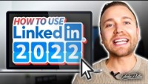
Video: Introduction to LinkedIn
Check out this handy video which explains how to get started with using LinkedIn, and has some useful tips and tricks when creating a LinkedIn account:
https://www.youtube.com/watch?v=3FnovWnhObs
Click to watch

Slide 44

Tool In Focus: Microsoft Teams
Microsoft Teams is a platform that gives its users a hub for teamwork. Teams uses channels rather than file folders and uses chats instead of emails. This change to the usual way of working in a team allows for each team member to access and work on the same files at the same time.
Teams allows for quick access to apps, documents, and files and can help you to stay focused and organized in one central place. Try adding tabs for your favourite tools, important files, collaborate real-time on documents, and store or share them easily with SharePoint integration into Teams. SharePoint is a web-based collaborative platform that integrates natively with Microsoft Office.
When you create a team in Teams, you get a SharePoint site automatically. SharePoint integration into Teams makes file sharing, storage, and collaboration easy.
Use Teams for collaboration on in-progress content, and SharePoint to review content and files
Tool Website: Microsoft Teams is for everyone

Slide 45
Tool In Focus: Microsoft Team
To join LinkedIn and create your profile:
Step 1: Navigate to the LinkedIn sign up page.
Type your first and last name, email address, and a password you'll use.
Note: You must use your true name when creating a profile. Company names and pseudonyms are not allowed, as we explain in our User Agreement.
Step 2: Click Join now.
Step 3: Complete any additional steps as prompted.
Click on this link for some tips about how LinkedIn can help you

Slide 46

Video: How to Collaborate on Teams
Watch this video which is a tutorial explaining how to use Microsoft Teams for collaboration and document sharing.
https://www.youtube.com/watch?v=YgG-px5XrpQ
Click to watch

Slide 47
Exercise/ activity - DeepL Translator
Click on the search engine deepl.com access their website
Two options will appear, one for translating text into 26 languages; and one for translating files. You must select the option you need.
In the case of translating a text, two columns will appear: in the first one, you enter the text and automatically detecting the language. In the right column, you must select the language into which you want to translate it. The translation will be automatic. At the bottom of this column, there are icons that allow you to copy the translation and share it. You only need to click on them to perform this action.
If we want to translate a file, we will have to select this action at the top. The files to be translated must be dragged or selected from the folder where they are stored on the computer. The translation will be automatic. At the bottom of the right column, there are icons that allow you to copy the translation and share it. You only need to click on them to perform this action.
With this tool you will be able to communicate and understand foreign language content more easily.

Slide 48

Topic 4: Netiquette and managing your digital identity

Slide 49
Relevant Definitions
Before we begin topic 4, here are some useful definitions to help you understand some of the information in this
module.
Netiquette is short for "Internet etiquette." Just like etiquette is a code of polite behaviour in society, netiquette is a code of good behaviour on the Internet. This includes several aspects of the Internet, such as email, social media, online chat, web forums, website comments, multiplayer gaming, and other types of online communication (SOURCE: techterms.com)
A digital identity is an online or networked identity adopted or claimed in cyberspace by an individual, organization or electronic device. These users may also project more than one digital identity through multiple communities. In terms of digital identity management, key areas of concern are security and privacy.
Digital footprints are the trail of data you leave behind while using the internet. These can include various activities like the websites you visit, what products you bought, and the likes, shares, and posts you make on social media. Your digital footprint also includes the devices that you use to access the internet and articles you have written or were written about you. It literally encompasses everything that can be found about you online, even the information that is hard to find.

Slide 50
8 Rules For Netiquette
Remember that you are interacting with a real person. Real people can have access to what you communicate online even when you are not aiming at anyone precisely with your messages.
Flaming is where you post inflammatory or offensive comments online. Avoid this completely. An example of what can happen when you do post inflammatory or offensive comments can be seen as a case study later in this topic.
Mind your reputation when communicating. Start by avoiding slang, acronyms, and text talk. Also make sure to proofread your messages before sending them.
Be polite online and try and offer help to people where you can.

Slide 51
8 Rules For Netiquette
Avoid replying to negative comments with more negative comments. Instead, try to break the cycle with a positive post.
Stick to the topic at hand. Be as empathetic and as agreeable as you can, and try to understand the other person’s point of view.
Exercise good judgment when sharing information with others online, do not overshare and mind your safety.
Respect the diversity of viewpoints and all types of diversity. Try not to be closed-minded when dealing with people online.

Slide 52

Extra Netiquette Tips
Netiquette depends on where you are in cyberspace. A post on a friend’s Facebook page requires less formality than an e-mail to a potential employer.
It is important to be mindful of using capital letters and offensive language. Using all capital letters can give the impression that you are shouting. Avoid offensive language or comments that attack the writer of the comment rather than his or her argument.
If you read a message that you suspect might be a personal attack, resist the temptation to fire off a response. Instead, let your response sit awhile before sending or request that your instructor resolves the situation.

Slide 53
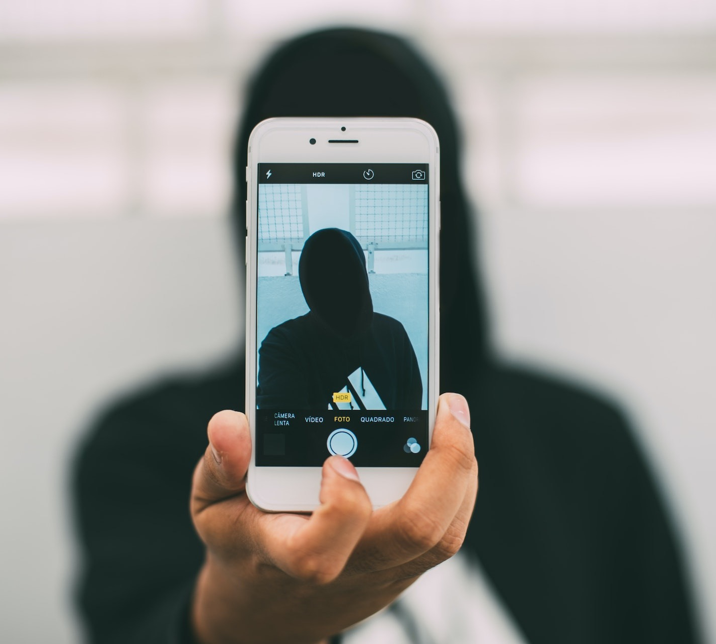
Being Your Best Online Self
The internet allows us to be mostly anonymous when we want to be. Whilst this gives us a lot of protection, it also means sometimes we can behave in ways online that we wouldn’t in real life.
It is very easy to become like a different person, or hide behind a mask. We see it constantly where people are becoming less authentic online and people present themselves and their lives in an untrue way.
This can potentially be damaging to your own self worth. It can also send mixed messages to your network or potential network.

Slide 54

Exercise: Being your True Self Online
Try the following exercise to practice being your true self online. Ask yourself:
“what is my purpose of being online?”
Spend a few minutes thinking about this question, and write down focusing on the following points
What exactly do you want to get out of your online engagement?
Why do you do what you do?
How do you present yourself online?
Are you honest online?
This reflection may help you recognize the true reasons behind your desire to be online.

Slide 55
Top Tips for Having an Authentic Online Identity
Authenticity means to be genuine or true. But what does this really mean in an online world?
Having authenticity means you need to walk your talk in order to be trustworthy. It also means you earn trust through honest, personable, and transparent interactions with your audience or network online.
Try not to change your personality or manner online to whatever the trending topic is at the time. It is important to be us, rather than who our audience want us to be.
Be aware of your persona online. This is the character that you portray online. You may apply for a job, and an employer has looked up and seen your social media accounts. They will have created a version of you in their heads based on this information. Does the information you have online match what you are like in real life?
Authenticity is not just about being sincere, real, and honest. It’s about being reliable, dependable, being true to what you say you will do, acting the way you say you will.

Slide 56

What is a Digital Footprint?
When we go online, we often leave a trail of data behind us. This can be interactions we have had on social media or forums online, or invisible forms such as This is what is known as a digital footprint.
Without realizing it, every day you are giving a constantly changing public presentation of who you are, which can be seen by anyone.
You might think you are at home on your laptops, mobile phones or tablets communicating with just a few friends but in reality, you are connected into a huge network that can record and redistribute everything you say.

Slide 57
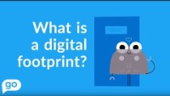
Click to watch
Video: What is a Digital Foodprint
Check out the following YouTube about 'what is a digital footprint?’ which will help you to understand the importance of a digital footprint for employees and those starting out in the job market!
https://youtu.be/CfICOt2uI80

Slide 58

Online Vetting or Cyber-vetting
Online vetting (cyber-vetting) is when potential employers go online to vet people's online presence or "internet reputation" ("netrep") on search engines such as Google and Yahoo.
Social networking websites can also be used such as Facebook, Twitter, Instagram and LinkedIn. Employers may check profiles, posts, and photographs for indications that the candidate is unsuitable.

Slide 59
Who is Interested in Your Digital Footprint?
Employers - Many employers use the internet and social media platforms for recruiting and checking the credentials of job candidates. As we saw in the previous slide, many employers cyber-vet their future employees before they for interview. Employers may also look up your information whilst in employment.
Police and Crime Prevention - Police in London have piloted software which analyses social media to try to predict which criminal gangs are most likely to commit violent crimes.
Healthcare - Researchers in America have analysed Twitter output to try to learn more about the psychological health of a community and predict rates of heart disease.
Online Service Providers - Regarded by some as intrusive, cookies enhance our interaction with our favourite websites and help speed up the loading of websites. However, these tiny bits of data can be used by other websites and programmes to give you target adverts.

Slide 60

Activity- Find Out the Size of Your Own Digital Footprint!
If you’re interested in the current size of your own digital footprint, you can download a copy of the Personal Digital Footprint Calculator. This tool walks you through a questionnaire that calculates your impact based on the responses to questions about your computer usage, email usage, digital camera/camcorder usage, web downloading habits, potential surveillance areas, and geographical information, among other things.
The questions make you think about your online activities, but can may be hard to answer if you’re not really aware of your online activities. Use this as an opportunity to think about your digital footprint more:
Try it out by clicking on the link here:

Slide 61
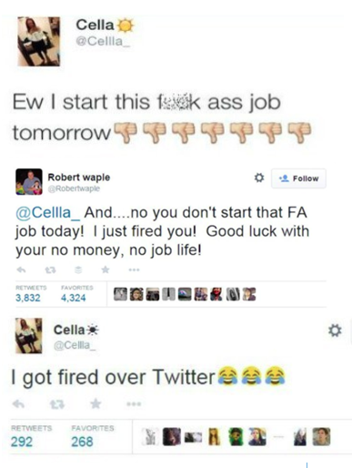
Case Study - Example of the Impact of Digital Footprint
The following case study is a real-life example of what can happen if you do not think about your digital footprint or having a positive digital identity online.
A teenage girl with the Twitter handle “@Cellla_” was successful in getting a job at a pizza restaurant. However, when it came to the day before she was due to start, she did not want to go to work at her new job. She Tweeted about it, and this led to her being fired!
Her would-be boss, Robert, saw the tweet (thanks to one his employees), and he let her know through Twitter that she didn’t have to bother showing up to work.

Slide 62
Case Study - Example of the Impact of Digital Footprint
This happened in 2015. She deleted the tweets in 2015 and shortly after that stopped using that Twitter handle but the digital footprint and legacy remain.
Seven years later the remains of this brief interaction can still be seen with the tweet featured on Failbook (a comedy blog website) and also on Twitter – there are hundreds of reaction tweets to her original post.
It is a good example of how you should always follow the netiquette advice that we mention at the beginning of this topic to make sure that nothing is ever used against you!

Slide 63
14 Tips for Managing your Digital Footprint
Regularly look yourself up online
Remember all of your online accounts
Use privacy settings
Keep things professional
Keep your profile up to date
Don’t overshare
Delete unflattering content
Check your browser for cookies
Protect your passwords
Use strong passwords
Create a second email account
Share your achievements
Think before you post
Always update your software

Slide 64
Activity - Find Out the Size of Your Own Digital Footprint!
If you’re interested in the current size of your own digital footprint, you can download a copy of the Personal Digital Footprint Calculator. This tool walks you through a questionnaire that calculates your impact based on the responses to questions about your computer usage, email usage, digital camera/camcorder usage, web downloading habits, potential surveillance areas, and geographical information, among other things.
The questions make you think about your online activities, but can may be hard to answer if you’re not really aware of your online activities. Use this as an opportunity to think about your digital footprint more:
Try it out by clicking on the link here:

Slide 65
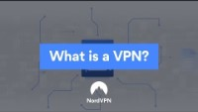
Watch: Managing your Digital Footprint Using Tools
There are many tools that you can use to help manage your digital footprint. One such way is by using a Virtual Private Network (VPN). VPNs mask your Internet Provider (IP) address which can keep your location, browsing history and other information private. Watch the video for more information.
https://www.youtube.com/watch?v=wrA86e--K3s
Click to watch

Slide 66

Search Engine Recommendations - DuckDuckGo
In Module 1, we explored different search engines that you can use. One search engine that is useful for managing your digital footprint is DuckDuckGo.
DuckDuckGo doesn’t track your data when you search for things online which means it can reduce your digital footprint. It offers private searches, website encryption and tracker blocking and works very similarly to Google, but does not store your information.
Check out the DuckDuckGo website by clicking on this link.

Slide 67
Deleting Your Digital Footprint
Take a look at the tips below to remove part of your digital footprint:
Remove yourself from data broker websites
Delete old email accounts
Create unique passwords for every online service
Log out of all apps and sites you’ve previously used
Delete your history on major service providers
Manage the location settings on your cell phone
Delete and deny cookie
Unsubscribe to newsletters and sales alerts
Request removal of unwanted information and pages from Google searches
Click here for a useful link that explains how to delete your data:

Slide 68
Exercise / activity - Telegram
You have to download the app called telegram, depending on your operating system.
You can access from your cell phone or from your computer by scanning a QR code.
Once you download the application, you will be able to chat with the contacts in your cell phone who have this application installed.
Once you select the recipient with whom you want to communicate, you will write in a bar -located at the bottom- the message you want to send. Then click on 'send’.
Messages will be sent automatically, and you will be able to communicate with all your friends in a seamless way.
Whenever you want to chat with them, all you have to do is access the application. You can also configure the settings to receive notifications when you receive messages.
Enjoy communicating with your friends!

Slide 69
End of Module 2
Thank you for reading Module 2, and we hope you enjoyed it and learned some useful information.
Module 3 of the Teach Digital OERs is titled “Digital Content Creation”. Here, you will find more information on the following topics:
Topic 1 - Developing digital content
Topic 2 - Integrating and re-elaborating digital content
Topic 3 - Understanding copyright and licenses
Topic 4 - Programming - quick solutions

